Slide 1
Clustering by Passing Messages Between Data Points
Brendan J. Frey and Delbert Dueck
Science, 2007

Slide 2
Outline
Introduction
Method Description
Experiments
Conclusion

Slide 3
Introduction
Clustering: based on a measure of similarity to cluster data.
Exemplar: the centers are selected from actual data points.

Slide 4
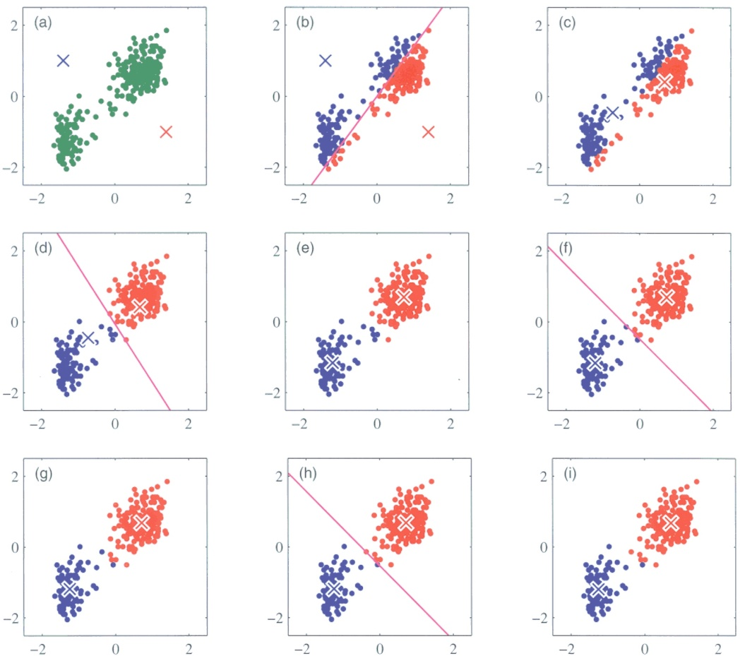
Introduction
A common approach: k-centers clustering.
It’s sensitive to the initial selection of exemplars.

Slide 5
Introduction
In k-means algorithm, the number of exemplars need be specified beforehand.
How to apply clustering if we don’t know the number of exemplars?

Slide 6
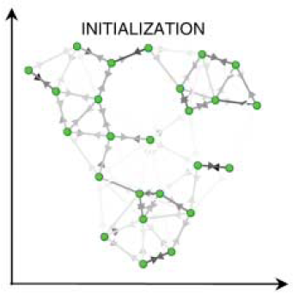
Method Description
A new approach: affinity propagation.
We view each data point as a node in a network and consider all data points as potential exemplars.

Slide 7
Similarity and Preference
Affinity propagation needs two information
  Similarities between data points:
  Preferences:
Similarity indicates how well the data point k is suited to be the exemplar for data point i.
Preference influences the number of clusters.

Slide 8
Messages exchanged
Affinity propagation recursively transmits real-valued messages along edges of the network until a good set of exemplars and clusters emerges.
The messages include:
  responsibility
  availability
Availabilities and responsibilities can be combined to identify exemplars.

Slide 9
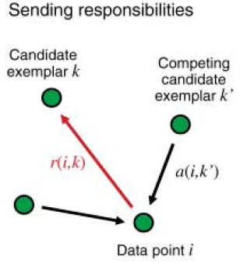
Responsibility and availability
Responsibility : reflects the accumulated evidence for how well-suited point k is to serve as the exemplar for point i.
From data point i to candidate exemplar point k, it takes into account other potential exemplars for point i.

Slide 10
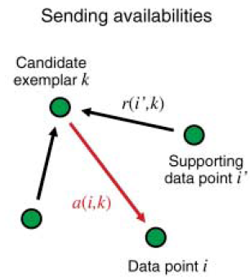
Responsibility and availability
Availability : reflects the accumulated evidence for how appropriate it would be for point i to choose point k as its exemplar.
From candidate exemplar point k to point i, it takes into account the support from other points that point k should be an exemplar.

Slide 11



How to send messages?
The availabilities are initialized to 0, , it means each point doesn’t decide which exemplar it belongs to.
The responsibilities are updated by:
(For the first iteration.)
If r is bigger, it means the point k is more well-suited for point i than other exemplars k’.

Slide 12
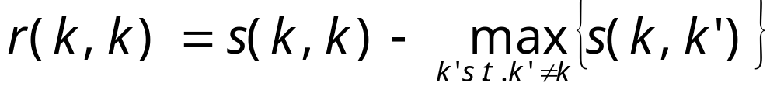

How to send messages?
Self-responsibility : for i = k, it will be
preference
The similarities with all other exemplars.
How appropriate it would be for data point k as an exemplar itself?
If , exemplar is more appropriate to belong to other exemplars.

Slide 13



How to send messages?
Availabilities are updated by:
It’s the sum of responsibilities for supporting points i’ to exemplar k.
If a = 0, it means exemplar point k is more well-suited to point i.

Slide 14
How to send messages?
If availability is less than 0, it will increase the other points’ responsibility:
Availability < 0
Responsibility from data point i to exemplar k increases!

Slide 15


How to send messages?
Self-availability : for i = k, it will be
How appropriate it would be for data point k as an exemplar itself?
Based on the responsibilities from other data points i.

Slide 16
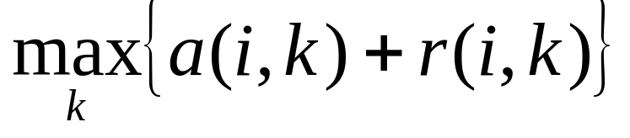
How to identify the cluster?
For point i, we would like to find:
If k = i, the data point i is an exemplar itself.
Otherwise, the data point k is the exemplar of point i.

Slide 17
Method Description
Each iteration of affinity propagation consisted of:
  Updating all responsibilities given the availabilities.
  Updating all availabilities given the responsibilities.
  Combining responsibilities and availabilities to monitor the exemplar decisions.
When does the algorithm terminate?

Slide 18
Method Description
The procedure may be terminated:
  after a fixed number of iterations.
  after changes in the messages fall below a threshold.
  after the local decisions stay constant for some number of iterations.

Slide 19
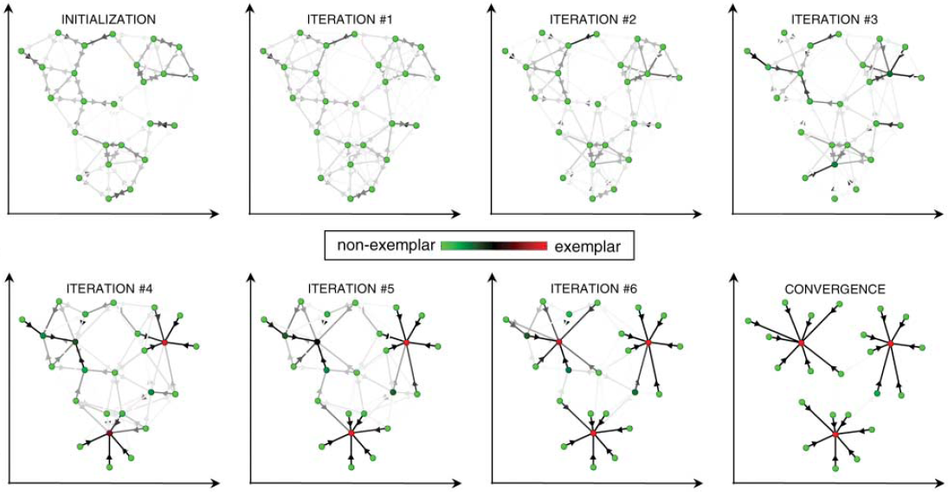
Method Description
For example:

Slide 20
Experiments
Clustering images of faces.
Clustering putative exons to find genes.
Identifying a restricted number of Canadian and American cities, in terms of estimated commercial airline travel time.

Slide 21
Clustering images of faces
Use affinity propagation and k-centers clustering.
900 grayscale images extracted from the Olivetti face database.

Slide 22
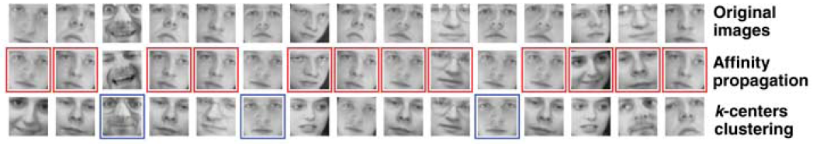
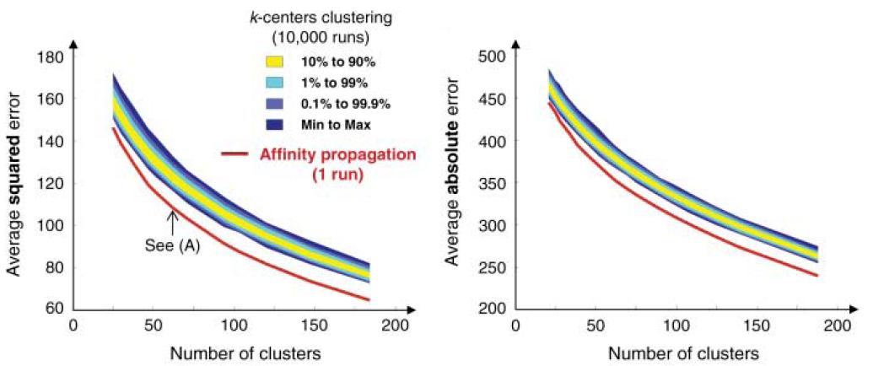
Clustering images of faces
Experimental results:

Slide 23
Clustering putative exons to find genes
75066 segments of DNA (60 bases long) corresponding to putative exons were mined from the genome of mouse chromosome 1.
The measure of similarity between putative exons was based on their proximity in the genome and the degree of coordination of their transcription levels across the 12 tissues.

Slide 24
Clustering putative exons to find genes
The similarity matrix consisted of 99.73% similarities with values of -∞, corresponding to distant DNA segments that could not possibly be part of the same gene.

Slide 25
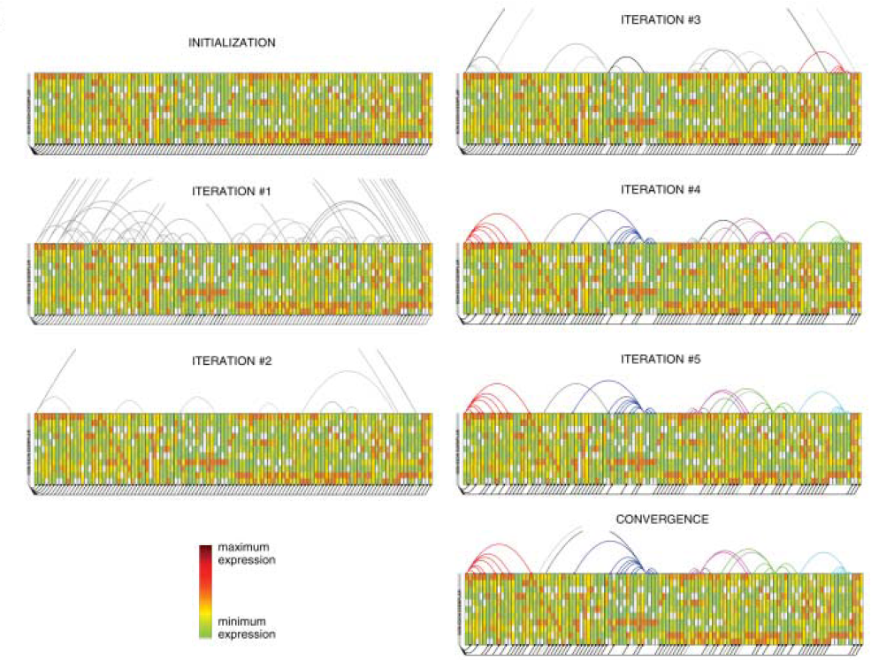
Clustering putative exons to find genes
Experimental results:

Slide 26
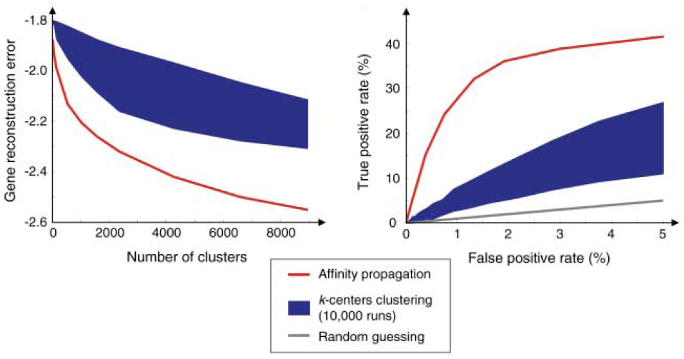
Clustering putative exons to find genes
Experimental results:

Slide 27
Identifying the cities
Due to headwinds, the transit time was in many cases different depending on the direction of travel.
The 36% of the similarities were asymmetric.
Further, for 97% of city pairs i and k, there was a third city j such that the triangle inequality was violated because of a long stopover delay.

Slide 28
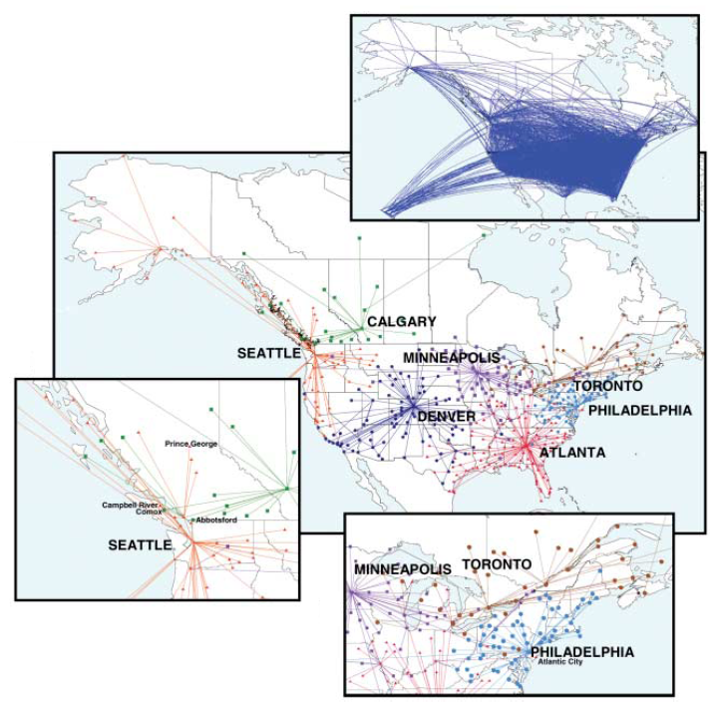
Identifying the cities
Experimental results:

Slide 29
Conclusion
Affinity propagation is the first method to make use of the idea ‘message passing’ to solve the fundamental problem of clustering data.
Because of its simplicity and performance, it will prove to be of board value in science and engineering.

